Slide 1



A history of HTML, HTML standards & browser compatibility
#getyourheadaroundcode @lpoolgirlgeeks

Slide 2
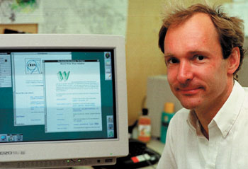
HTML: a brief history...
1989
Tim Berners-Lee invented the World Wide Web.
1990
Tim Berners-Lee wrote the first web browser and server.
Berners-Lee made his findings freely available and the web was allowed to flourish.
#getyourheadaroundcode @lpoolgirlgeeks

Slide 3
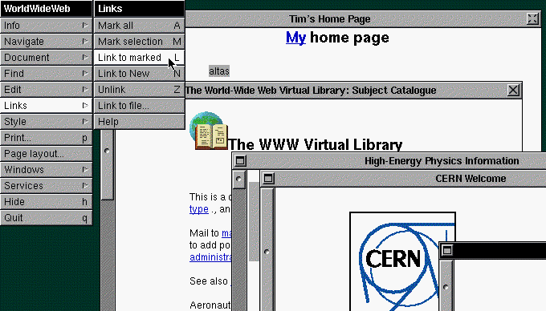
World’s first web browser
#getyourheadaroundcode @lpoolgirlgeeks

Slide 4
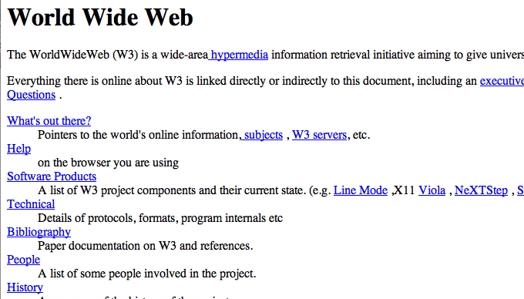
The world’s first web page was launched in 1991
#getyourheadaroundcode @lpoolgirlgeeks

Slide 5

W3C’s mission to lead the web to it’s full potential.
1994
Berners-Lee founded the World Wide Web Consortium (W3C).
Adherence to web standards refers to development of web pages that validate according to the W3C recommendations.
#getyourheadaroundcode @lpoolgirlgeeks

Slide 6

When you ask a browser for a web page, the
request is sent across the internet to a web server
JavaScript
PHP
.NET
Ruby
are all examples of programming languages
that can be used for more complex sites.
#getyourheadaroundcode @lpoolgirlgeeks

Slide 7


The Web Hypertext Application Technology Working Group (WHATWG)
2004
The WHATWG was founded by individuals from Apple, the Mozilla Foundation and Opera Software to evolve HTML and related technologies.
2007
The WHATWG and W3C agreed to use proposed WHATWG HTML5 working standard.
#getyourheadaroundcode @lpoolgirlgeeks

